Slide 1
The Need of Research-based Innovation for Islamic Finance and Takaful Industry
Prof Dr Azmi Omar
President & CEO

Slide 2
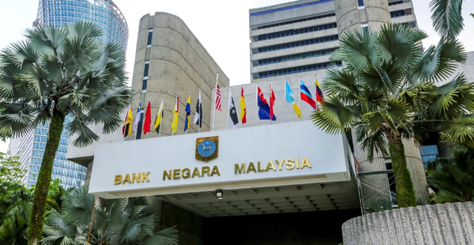
World’s First And Only University Dedicated To Islamic Finance
Our Vision: To Be The Knowledge Leader in Islamic Finance
About INCEIF
Globally Respected Faculty Members
Academic Quality
Research
AACSB Accredited
Top in Islamic Finance Research & Publications
INCEIF joins the top 5% of business schools worldwide
The only Islamic Finance university in Malaysia to be accredited.
Since 2015, INCEIF’s research has been ranked top 10 in Malaysia amongst the higher education institutions in the Research Papers in Economics (RePec) rankings.
Established by Bank Negara Malaysia (Central Bank of Malaysia) to develop talent and provide knowledge leadership for the global Islamic finance industry.

Slide 3
Content
Introduction
Critical Success Factors for Takaful
The Need for Research-based Innovation
Notes:
Mr. Ventje Rahardjo (Executive Director, KNEKS)
Senior officials from participating agencies
Fellow Speakers:
Brothers & sisters
Assalam.
Thank you for inviting me to share my thoughts on the webinar topic The importance of research in supporting current development of Islamic economy.
Congratulate the members for signing the MOU to organize the 13th IE conference
My topic this afternoon will not cover the areas of research of Islamic Economy but rather the method of how research and innovation in IE should be organised so that we have impactful applied research for the country’s development. The areas of research will be covered by my colleagues here

Slide 4
Introduction
YOY Growth rate : 14%
YOY Growth rate : 15%
YOY Growth
rate : 6%
YOY Growth
rate : 15%
YOY Growth
rate : 10%
Source: Islamic Finance Development Report 2020

Slide 5
Introduction
Insurance penetration in Ethiopia is among the lowest in Africa
Estimated to be less than 0.6%
The challenge for Takaful in Ethiopia will be the same or somewhat similar

Slide 6


Critical Success Factors for Takaful
Number of Takaful & Retakaful Companies
Omni Channels – branches, agents, banca takaful, digital
General Takaful
Family Takaful
Broad
Product
Offering
Accessibility
Regulatory
Framework & Govt
Policies
Growing Market Demand
Human Capital
Awareness
Education
Promotions & Campaigns
Research
Education
Talent Development
Conferences
Seminars

Slide 7
The Need for Research-based Innovation
1. Market Demand
  Research
    To understand the level of awareness about Takaful – public, students, business community, corporates and government
    To educate – public, students, business community, corporates and government about Takaful
    Devise the right promotion and campaign tools
2. Product Offering
  Research
    Types of products to meet the demand of the market – general and family
    Start with basic simple products and later develop innovative products

Slide 8
3. Accessibility
  Research
    How to market the Takaful products? What works and what doesn’t?
    Takaful branches, banca Takaful, agents, digital
4. Human Capital
  Talent development
  Research
  Others

Slide 9

www.inceif.org
INCEIF, The Global University of Islamic Finance
Lorong Universiti A, 59100 Kuala Lumpur.
Tel: +603 7651 4000
E-mail : azmiomar@inceif.org
www.facebook/inceif
www.instagram/inceif_my
www.twitter/inceif
www.linkedin.com

